Slide 1


IoT Automated Door
( Paper id: EMERGIN-2023-02-05-126 )
Presented By:-
Team Member | Designation
Aman Vishwakarma | B. Tech (CSE IoT) NIET
Hemant Kumar Verma | B. Tech (CSE IoT) NIET
Sahil Srivastava | B. Tech (CSE IoT) NIET
Utsav Kumar Malviya | Assistant Professor (CSE IoT) NIET

Slide 2
INTRODUCTION
Since from the Covid-19 arises, touching things like door ,window , etc is not considered safe due to the fear of infection.
We likely to introduce Electronic Door for such a problem embedded with the latest stack of technology i.e. Internet of Things .
With the help of IoT using IoTGecko website user can control, check status of the door.
It provides statistical features like accessing remotely , 24x7 control , low or easily maintenance .

Slide 3
LITERATURE SURVEY
Title | Summary
IoT Enabled Door Lock System By Trio Adiono , Syifaul Fuada Sinantya Feranti Anindya , Irfan Gani Purwanda Maulana Yusuf Fathany | In this paper, a prototype of location-based smart door lock system is designed. The system utilizes the user‟s GPS coordinate that is captured from a mobile application, which is then sent to a smart home system‟s central host to enable or disable the door lock based on the user‟s proximity to the door‟s designated GPS coordinates. Based on the testing conducted, it can be concluded GPS coordinates can be used for controlling door lock. However, further study is required to improve the quality of the system, whether in terms of power efficiency, area tracking and indoor accuracy, and further increase the security | Pros: It covers the design of a prototype for IoT and GPS enabled door lock system. It signifies the uses of STM32L100 microcontroller and Xbee module
 |  | Cons: GPS coordinates are the input for door locking and unlocking.
DESIGN AND IMPLEMENTATION OF DOOR ACCESS CONTROL AND SECURITY SYSTEM BASED ON IOT By G.Sowjanya, S.Nagaraju | This paper presents the design and implementation of an interactive home/other applications security system using biometric with IoT Server. IoT based monitoring and control of equipment is forming a trend in automation field. This system mainly used in high security applications such as museums, bank lockers, home applications, libraries, ATM’s, shopping malls, laboratories etc. Remote operating can be done using IoT Server. In addition to this, sensors will give the current status of the system using IoT, thus enhance the security and eliminates the human monitoring near the system | Pros Explains use of IoT Server along with Raspberry pi2.
 |  | Cons Not feasible for the system development cost.

Slide 4
Title | Summary
Development of IoT Automated Door Lock System Using Blynk Application By Mohamed Affiq Mohamed Bakhory , Suzanna Ridzuan Aw , Nurul Huda Mat Tahir , Arfah Syahida Mohd Nor , Farah Hanan Azimi , Lia Safiyah Syafie , Safuan Naim Mohamad , Nooraida Samsudin | This project is developed in purposes the most obvious improvement smart technology delivers to door locks are keyless system that strongly simplify the entry procedures to the point that you need to try and find the best home security system. House keys stand among the most commonly misplaced items. So, it is more convenient, that the user does not have to keep track of yet another key or worry about how to pass off the key to someone else. It ensures the convenient authentication and unlocks, so you don’t have to worry about lost or forgotten keys. This project has successfully achieved the objectives. The aim of this project is to build the IoT monitoring system by using Blynk application platform. This project consists of IoT system that was build up using the Arduino Wemos D1, ESP8266 as the microcontroller and the Blynk application as for the monitoring. | Pros 1-This system consists of IoT system that was build up using the Arduino Wemos D1, ESP8266 as the microcontroller and the Blynk application as for the monitoring. 2-The monitoring process of this door lock can be monitored anywhere and anytime
 |  | Cons Servo motor operate smoothly with Arduino WeMos and Blynk without any overshoots and lagging count by 200 until 400.

Slide 5
Problem Statement
IoT-based automated door system that offers improved security, convenience, and accessibility.
The system should allow authorized individuals to remotely lock or unlock the door, monitor its status in real-time, and grant access to specific individuals through a mobile application or web portal.
The system should also provide alerts to the owner in case of any unauthorized attempts to access the door.
The automated door should be compatible with various IoT devices and be able to integrate with smart home systems.

Slide 6
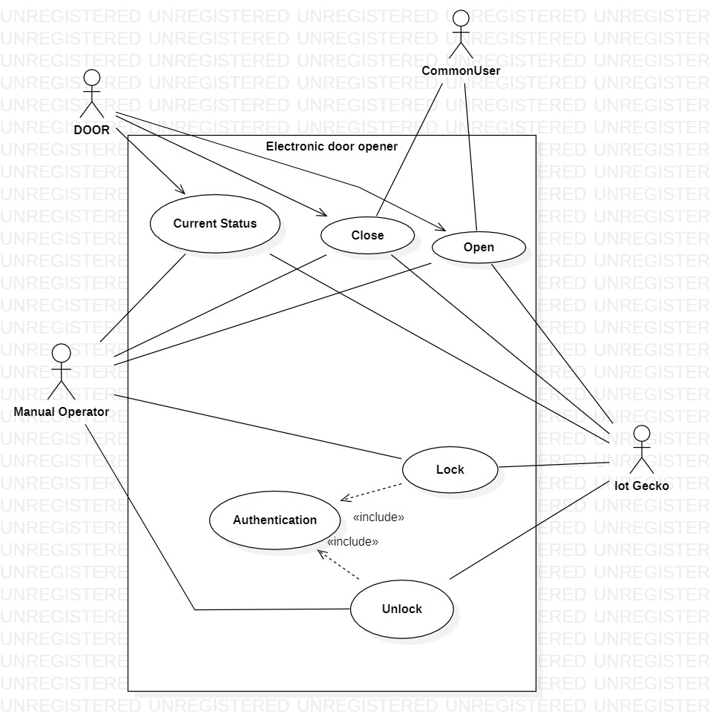
Proposed Methodology

Slide 7
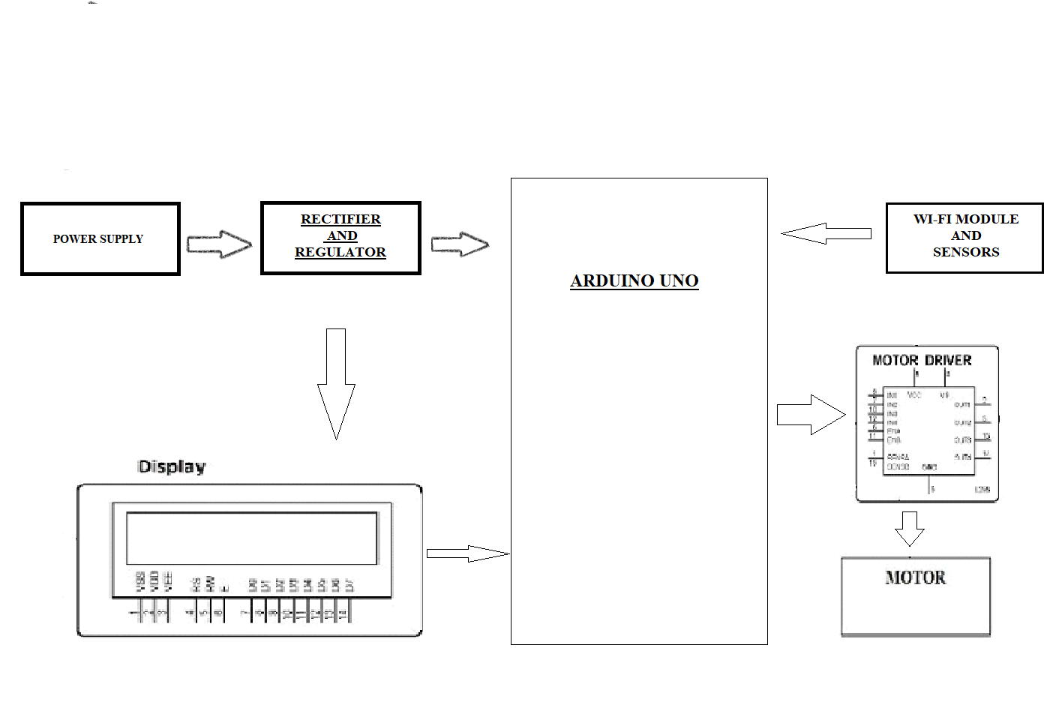
System Setup

Slide 8
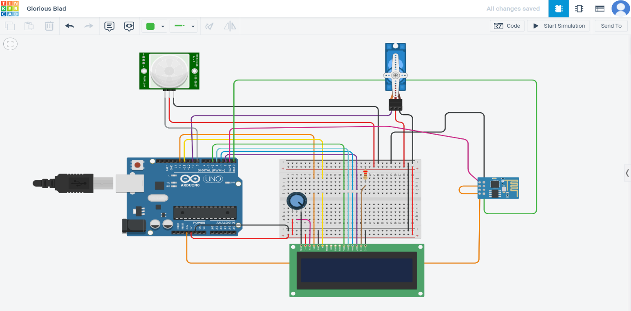
Hardware Implementation

Slide 9
Software Implementation
Mobile Application or Web Portal: The system requires a mobile application or web portal through which users can remotely monitor and control the door. The application or portal should be user-friendly and allow for easy management of access control.
IoT Devices: The system requires various IoT devices, such as sensors, cameras, and smart locks, to enable remote monitoring and control of the door. These devices should be compatible with the software and capable of communicating with each other.
Cloud Platform: The system requires a cloud platform for data storage, processing, and analysis. The cloud platform enables users to access real-time data and receive alerts in case of any security breaches.
APIs: The system requires APIs to enable communication between the IoT devices and the cloud platform. APIs allow for seamless integration of the system with other IoT devices and smart home systems.
Security Features: The system must have robust security features, such as multi-factor authentication, encryption, and access control, to prevent unauthorized access to the system and protect user data.
Testing and Maintenance: The system requires regular testing and maintenance to ensure its proper functioning. The testing should include functional and security testing to identify and fix any bugs or vulnerabilities.

Slide 10
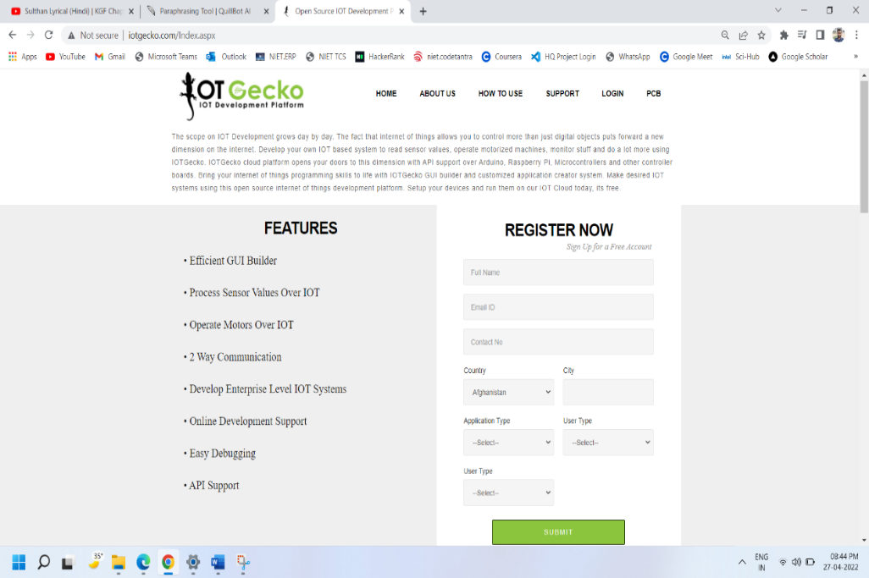
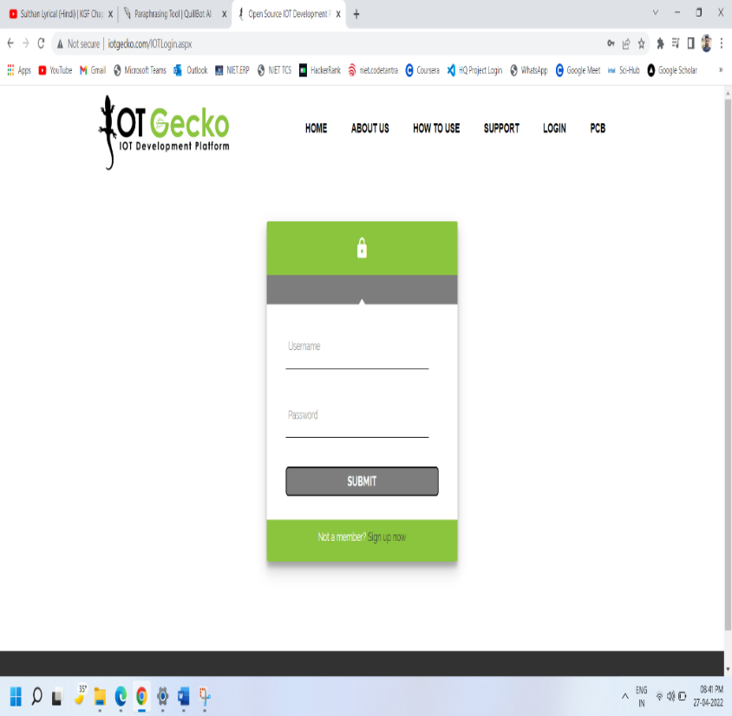
Software Implementation
Register now on the IOTGecko Web page | Login page of IoT Gecko

Slide 11
Result
The key features of an IoT-based automated door system include real-time monitoring, remote control, access control, compatibility with various IoT devices, and easy installation and maintenance.
The system also provides real-time alerts in case of unauthorized access attempts, ensuring that users can take appropriate action to prevent any security breaches.
The benefits of an IoT-based automated door system include enhanced security, improved accessibility, convenience, and seamless integration with other IoT devices and smart home systems.
This system is ideal for homeowners, businesses, and property managers who are looking for a more secure and efficient way to manage access to their premises.

Slide 12
Results
Case | Test | Position | Output
1 | When person is standing in front of door at 90° | Under 2 meters | Open
 |  | Above 2 meters | Closed
2 | When the person is standing at the centre of door | Centre of the door | Remains opened until he moves
3 | When person is standing at an angle of 45° to the door (left & right) | Under the 0.5 meter | Door opened
 |  | Above the 0.5 meter | Door closed
4 | When person is standing at 90° inside to door | Under 2 meters | Door remains Opened
 |  | Above 2 meters | Door gets closed
5 | When person is standing at an angle of 45° inside door (left & right) | Under 0.5 meter | Door remains opened
 |  | Above 0.5 meters | Door gets closed

Slide 13
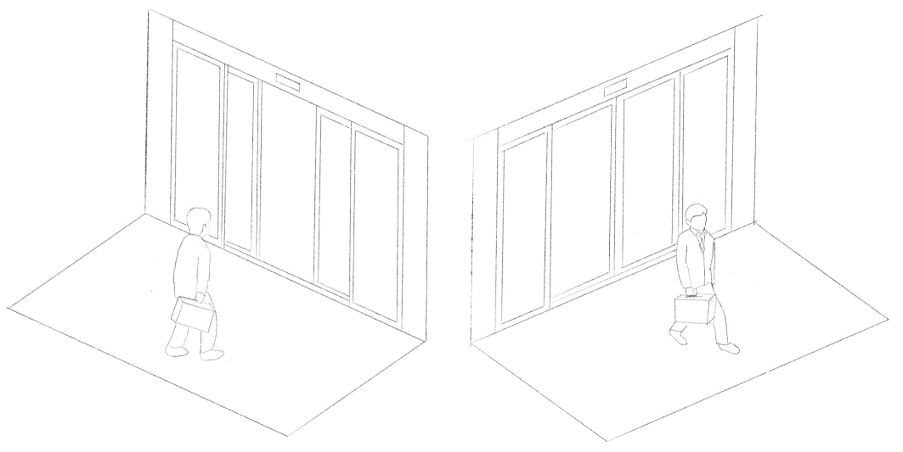
Demo of Door

Slide 14
Conclusion
Through this project, we can conclude that we can open the door when it is closed and we can close the door when it is open remotely from any place using ESP8266, Arduino Uno, PIR, Servo motors, and IoT Gecko.
Process of opening the door when someone opens the adafruit.io server from any phone or PC, we can control the gate with the help of Atmega328 Arduino IC, PIR, Wi-Fi module, and servo motor. With the help of an automatic gate, we can guard our college, House, and other property by controlling the entry and exits in the area.
It will provide convenience to the owner of the area by controlling entry and exit of the door.[2],[1] There are some disadvantages of automatic door openers like they are pricier than the normal gate. Installation and maintenance costs will also be high. If any component of the gate stops working, then obviously there will be trouble to open the gate.

Slide 15
References
Nayana R and Shashidhar R, “Smart Door Lock System,” International Journal for Modern Trends in Science and Technology, Vol. 05, Issue 02, February 2019
A Novel Recommender System in IoT Remo Manuel Frey¹, Runhua Xu¹, and Alexander Ilic²
Consumer IoT: Security Vulnerability Case Studies and Solutions Tejasvi Alladi, Vinay Chamola, Biplab Sikdar, and Kim-Kwang Raymond Choo
IoT-based Home Automation using Raspberry pi S. Indumathi¹, Nagabhirava Sravyasruthi^{2,} and S. Neha Vimala³, ^{1,2,3}CMR College of Engineering and Technology
https://www.researchgate.net/publication/337000920_Automated_Data_Acquisition_and_Controlling_System_in_Housing_Line_Using_Internet_of_Things_IoT
Arduino, https://www.arduino.cc/en/main/arduinoBoardUno
A review of the use of Nodemcu ESP8266 in IoT products ¹ Yogendra Singh Parihar ¹ Scientist D and District Informatics Officer ¹ National Informatics Centre, Mahoba(U.P.), India
MOTION DETECTION USING PIR SENSOR ¹Ajay Kumar Tiwari, ²Prince Raj, ³ Justice Kumar, ⁴Mr. Ashish Tiwary, Gandhi Institute of Engineering & Technology Department of Applied Electronics & Instrumentation Engineering Gunupur, Rayagada, Odisha, India
https://www.researchgate.net/publication/250928842_Passive_Infrared_PIR_Sensor_Based_Security_System?enrichId=rgreq-3f8a0827acc21b8ca4881ca3855c6005-XXX&enrichSource=wODExMzc2ODky&el=1_x_2&_esc=publicationCoverPdf
exploring the serial capabilities for 16x2 lcd interface, Pooja Soni¹, Kapil Suchdeo² ¹ Research scholar, ² T&P Head, Acropolis Institute of Technology and Research, Indore, Madhya Pradesh, India
interfacing a servomotor with arduino uno microcontroller Moyeed Abrar Department of Computer Science & Engineering, Khaja Banda Nawaz College of Engineering, Kalaburagi, Karnataka, India

Slide 16
Thank You

